Slide 1

BOOST::BEAST
REST API
USING IN C++

Slide 2
Something about BOOST::BEAST
FOR WHAT? JG REBOOT
REST API
HTTP Protocols
BEAST
BEAST BENCHMARK AGAINST OTHER LIBS
Linking BEAST WITH ASIO
Listener
Session
CONCLUSION
REFERENCES

Slide 3

Something about BOOST::BEAST
What you need to know to understand boost::beast:
Layered Network Model (ISO/OSI)
ASIO
Network Protocols

Slide 4
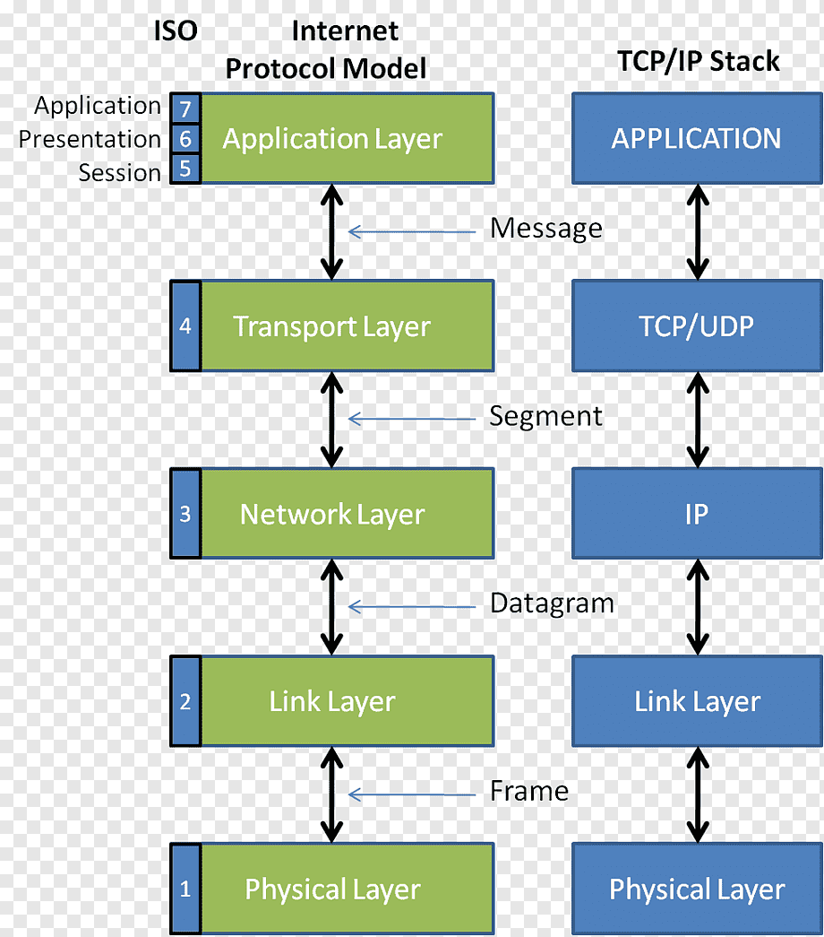
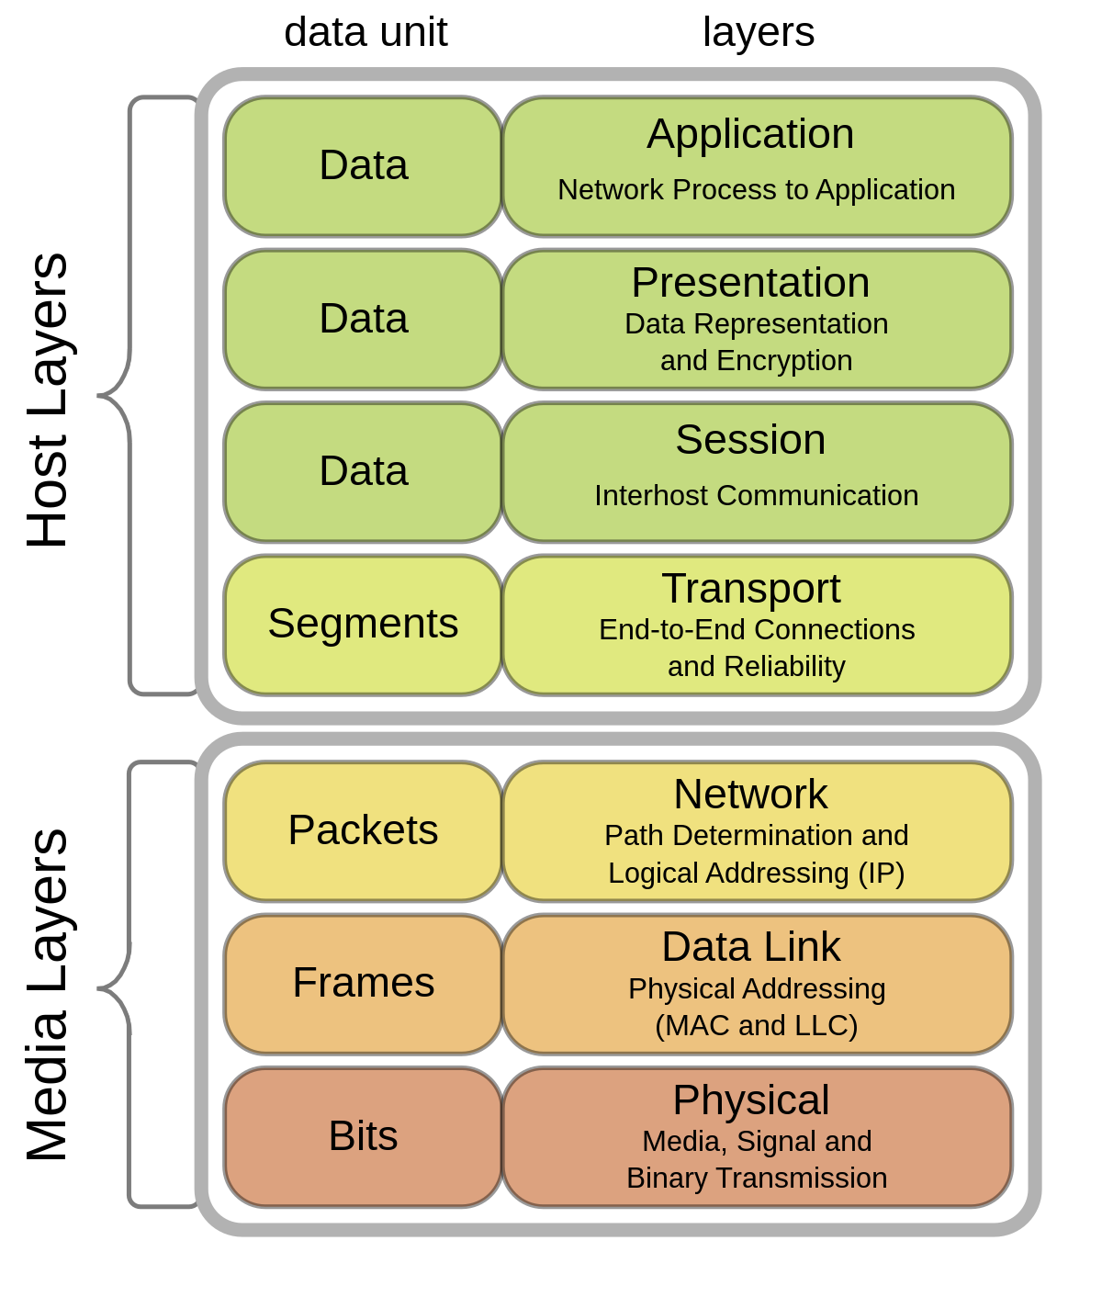
The Internet Protocol Stack Model
Layered Network Model (ISO/OSI)

Slide 5
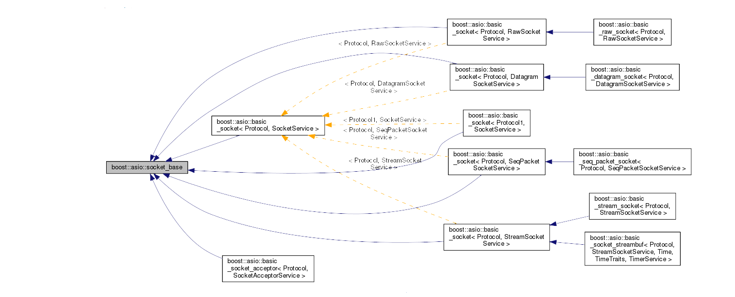
ASIO Model

Slide 6

FOR WHAT?

Slide 7

JG REBOOT

Slide 8
REST API
REST API (Representational State Transfer Application Programming Interface) is an architectural style used to create web services that exchange data with clients over HTTP.
The REST API is used to exchange data between client and server applications using the HTTP protocol.
The REST API relies on the use of standard HTTP methods such as GET, POST, PUT and DELETE to perform operations on resources.
In the REST API, each resource is represented by a unique URL, and client applications can send requests to that address to access the resource.
The REST API uses data formats, such as JSON or XML, to represent resources and transfer data between the client and the server.
The REST API is used in many applications, such as social networks, messengers, online stores, and others, and allows you to create flexible and scalable web services that can exchange data with client applications on different platforms and devices.

Slide 9
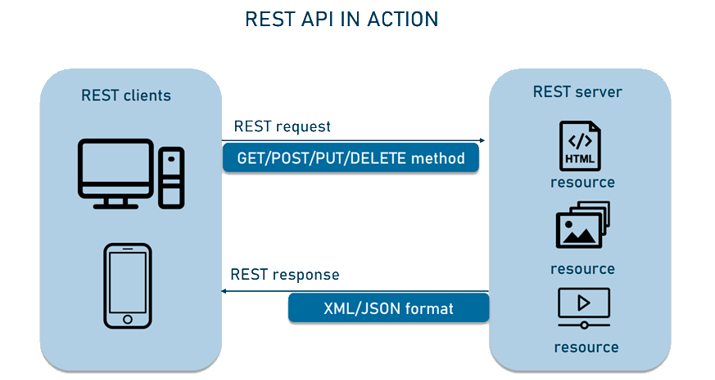
REST API

Slide 10
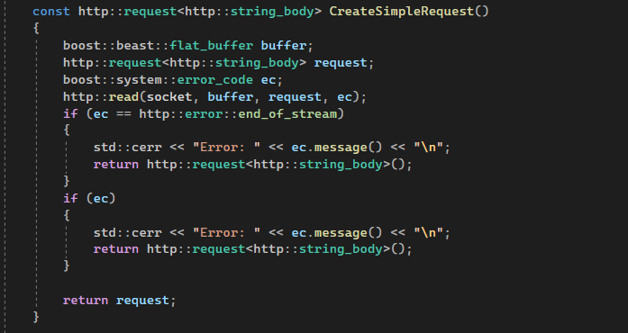
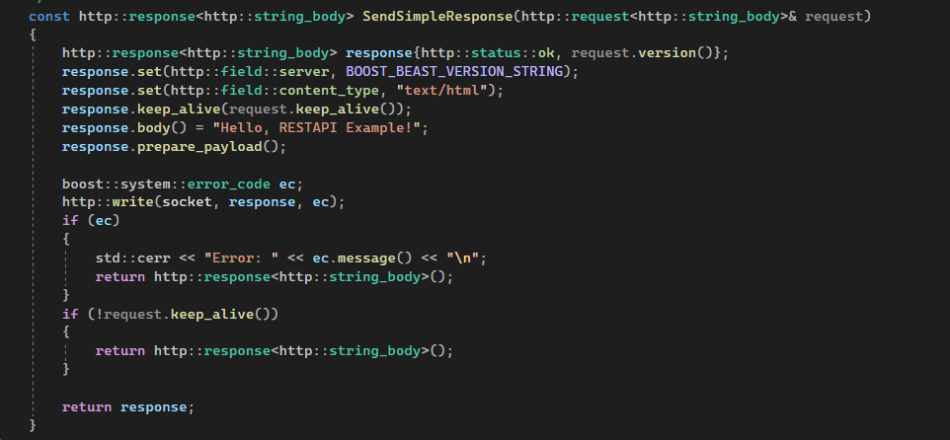
REST API
Here's an example of using Boost.Beast to create a simple REST API:
Client role: telnet
https://github.com/memorisecodead/BeastExample/blob/main/Examples/RESTAPI/SimpleRESTAPI.hpp

Slide 11
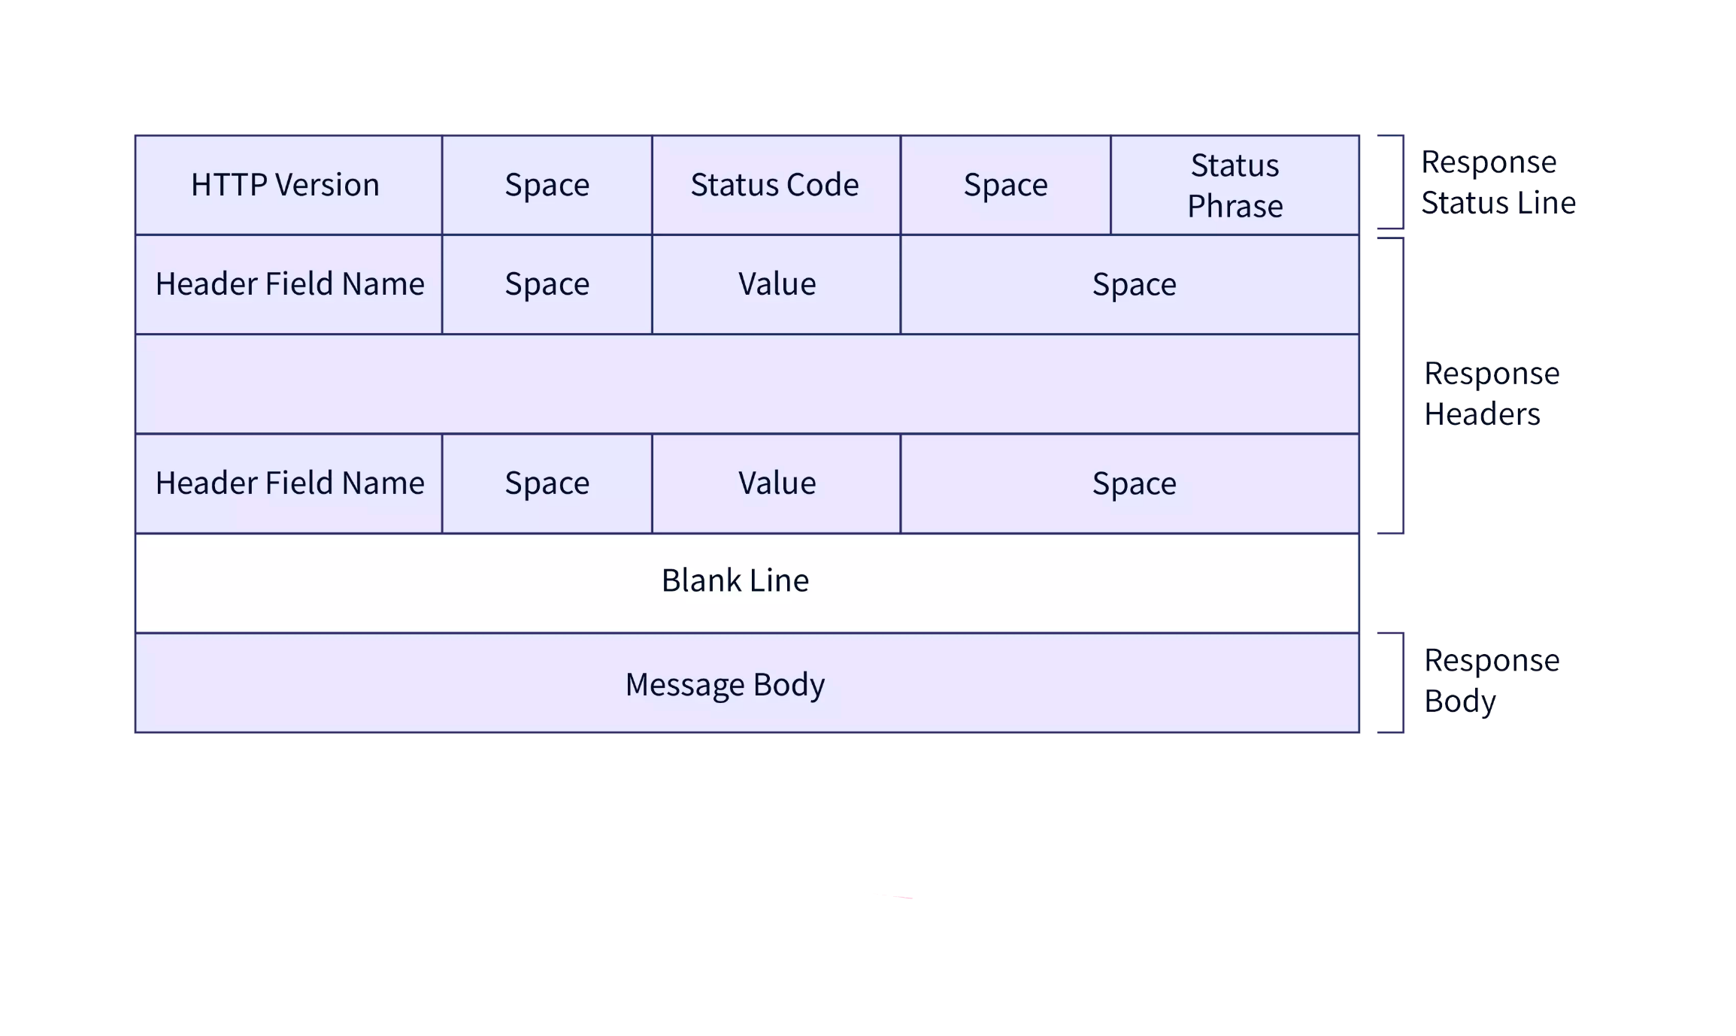
HTTP PROTOCOLS
HyperText Transfer Protocol is an application layer protocol used to
transfer data between a client and a server on the Internet.
There are several versions of the HTTP protocol:
HTTP/0.9
HTTP/1.0
HTTP/1.1
HTTP/2
HTTP/3

Slide 12
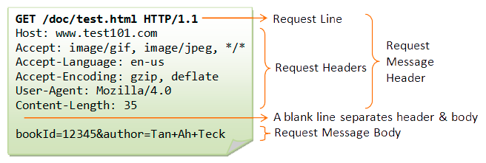
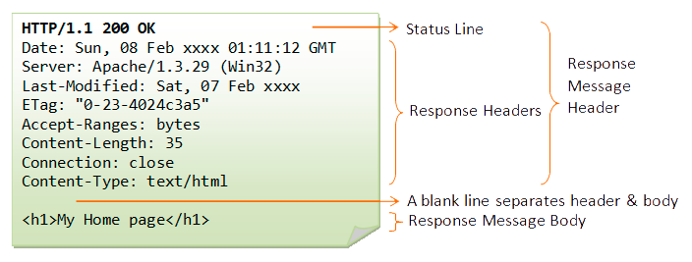
HTTP Request
HTTP Response

Slide 13
HTTP PROTOCOLS
http::request<http::string_body> req{verb, target, version}; - creating a request with a specific verb, target, and http protocol version
req.set() - is used to set the HTTP header value. It has three overloads:
req.set(http::field::host, _host); - The first overload takes the header name as string_view and the header value as string_view. This method replaces any existing header value with the new value specified in value.
req.set(http::field::user_agent, BOOST_BEAST_VERSION_STRING); - The second overload takes a field object, which represents an HTTP header. This method replaces any existing header value with the new value specified in the field object.
req.set(http::field::content_type, "application/x-www-form-urlencoded"); - The third overload takes a field object, which represents the HTTP header, and the header value specified as string_view. This method replaces any existing header value with the new value specified in value.
https://github.com/memorisecodead/BeastExample/blob/main/Examples/HTTPRequests/HTTPExample.hpp

Slide 14
HTTP PROTOCOLS
http::response is an HTTP response class that is used to send content to the client. It can be parameterized with different response body types, such as http::string_body, http::file_body, http::buffer_body and others.
The http::response class has many methods to set response properties, such as HTTP version, response status, headers, response body and others. For example, to set response status and "Content-Type" header, you can use the following code:
http::response<http::string_body> res;
res.version(version);
res.result(status);
res.set(http::field::server, BOOST_BEAST_VERSION_STRING);
res.set(http::field::content_type, "text/html");
https://github.com/memorisecodead/BeastExample/blob/main/Examples/HTTPRequests/HTTPExample.hpp

Slide 15
BEAST
Ease of use
High performance
Multithreading support
Multi-protocol support
Cross-platform
Extensibility
Beast supports the following versions of the HTTP protocol:
HTTP/1.0
HTTP/1.1
HTTP/2

Slide 16
BEAST
https://github.com/memorisecodead/BeastExample/tree/main/Examples/HTTPServer

Slide 17
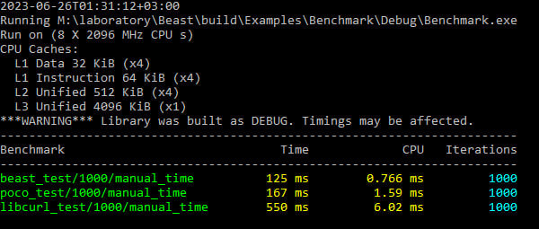
BEAST BENCHMARK AGAINST OTHER LIBS
For this benchmark, the following test code was written, which performs 1000 HTTP GET requests to Google and measures the average execution time of the request and the number of requests per second:
The benchmark was run on a machine with AMD Ryzen 5 3550h processor and Windows 22H2 operating system. The code was compiled with MSVC 14.32.31326.
Below are benchmark results comparing Beast, Poco, and Libcurl libraries for HTTP queries:
Lib versions:
boost/1.81.0 (beast/1.82.0)
poco/1.12.4
libcurl/8.1.2
https://github.com/memorisecodead/BeastExample/blob/main/Examples/Benchmark/main.cpp

Slide 18

ASIO
Asynchronous programming model
Multi-threading support
Support of various protocols
Cross-platform
Ease of use
Wide user community

Slide 19
ASIO
The main components of asio are:
io_context is a class that manages asynchronous I/O operations. It provides a mechanism for queuing tasks and executing them asynchronously.
ip::tcp::socket is a class that represents a TCP socket. It is used to establish a connection with a remote host and exchange data.
ip::tcp::acceptor is a class that is used to listen for incoming connections on the server.
ip::udp::socket is a class that represents a UDP socket. It is used to send and receive datagrams.
ssl::stream is a class that represents a secure SSL connection. It is used to establish a secure connection and exchange data with a remote host.
https://github.com/memorisecodead/BeastExample/blob/main/Examples/ASIO/ASIOExample.hpp

Slide 20

Linking BEAST WITH ASIO
Beast at its core uses Asio to implement the asynchronous I/O needed to handle HTTP and WebSocket protocols. Asio provides mechanisms for asynchronous data reading and writing as well as for managing network connections.
Thanks to asio, it is possible to use SSL to make a secure HTTPS request.
Thus, Beast and Asio are closely related: Beast uses Asio to implement asynchronous I/O, and Asio provides the necessary functions and classes to handle asynchronous I/O in Beast. Using Asio allows Beast to provide high performance and efficiency with HTTP and WebSocket protocols.

Slide 21

Listener
The Listener class is a convenient class that wraps the tcp::acceptor object and handles incoming connections in a separate thread. It also manages the creation and removal of Session objects for each client. To create a server in Boost.Beast, you normally create a Listener object by passing it an io_context object, which is used to manage asynchronous I/O operations. You can then call the start() method of the Listener object, which will start listening to the port and handling incoming connections. When the server should be stopped, you can call the stop() method of the Listener object, which will stop listening to the port and terminate the server.
https://github.com/memorisecodead/BeastExample/blob/main/Examples/HTTPServer/Listener.hpp

Slide 22

Session
The Session class is used to manage the client connection lifecycle. It processes requests sent by the client and sends them responses. A Session object can be created for each client that connects to the server, and will be destroyed when the client connection is closed. Boost.Beast also has a tcp::socket class, which is used to communicate with the client. When the server accepts a new connection, it creates a new tcp::socket object for that connection and passes it to the Session object, which will use it to communicate with the client.
https://github.com/memorisecodead/BeastExample/blob/main/Examples/HTTPServer/Session.hpp

Slide 23

CONCLUSION

Slide 24




REFERENCES

